Slide 1

Yelp Data Analysis
Saurabh Rao
Vineet Dandekar

Slide 2
Background - Dataset
2.2M reviews and 591K tips by 552K users for 77K businesses
566K business attributes, e.g., hours, parking availability, ambience.
Social network of 552K users for a total of 3.5M social edges.
Aggregated check-ins over time for each of the 77K businesses

Slide 3
Analysis
Predictive Model for Predicting the Success Rate for a NEW Business based on factors other than food quality.
Algorithm to Guess the Rating of a Review from its Text.
Model to Recommend a Business (Restaurant) to a User.

Slide 4





Technologies
Hadoop 2.7
Hive
Mahout
Microsoft Azure Machine Learning
Java 8

Slide 5

Prediction Analysis Using Microsoft Azure Machine Learning

Slide 6
Some Initial Analysis…
Loaded entire dataset into HIVE
Analyzed data using HIVE queries and Qlik Sense
Recognized trends in the Business dataset
Decided to create a predictive model

Slide 7
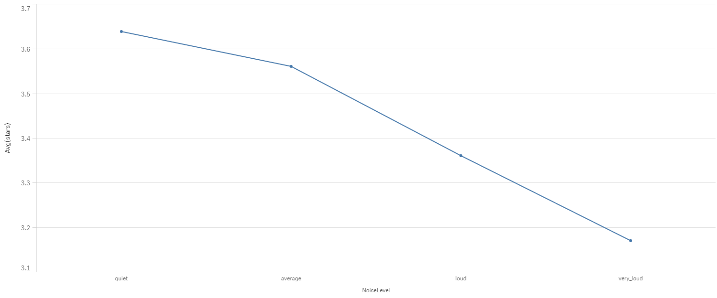
Some Initial Analysis… (Avg Ratings vs Noise Level)

Slide 8
Predictive Model Demo

Slide 9
Text Analysis for Reviews

Slide 10
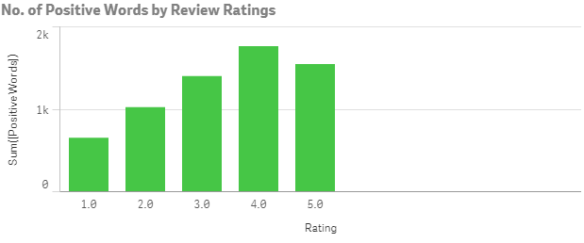
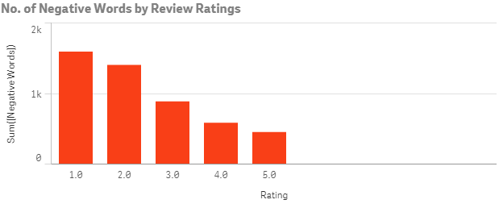
Basic Analysis for the Review Texts

Slide 11
Yelp Dataset Problem
How well can you guess a review's rating from its text alone?

Slide 12
Text Analysis Demo

Slide 13
Recommendation Using Mahout
Will be switching to Ubuntu for the demo….

